Slide 1
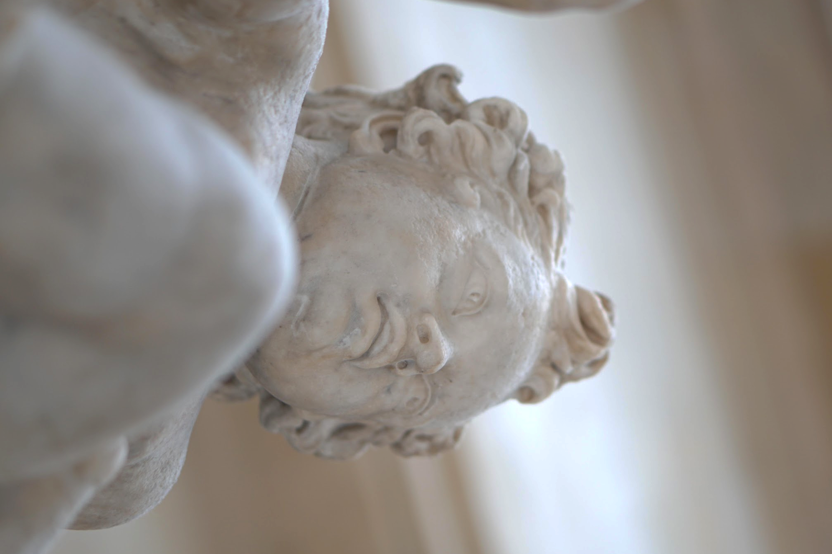
NEED
TO
CREATE
–
Vincent Nicandro, Lexi Stein,
Casey Wong, Zach Goodale

Slide 2
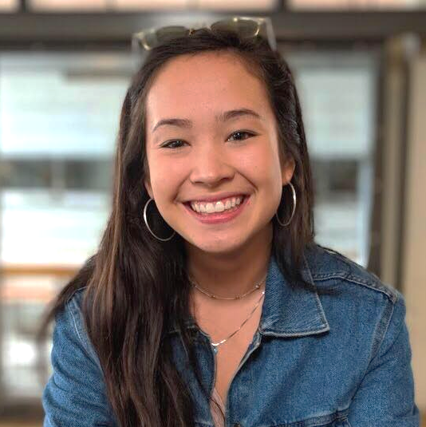
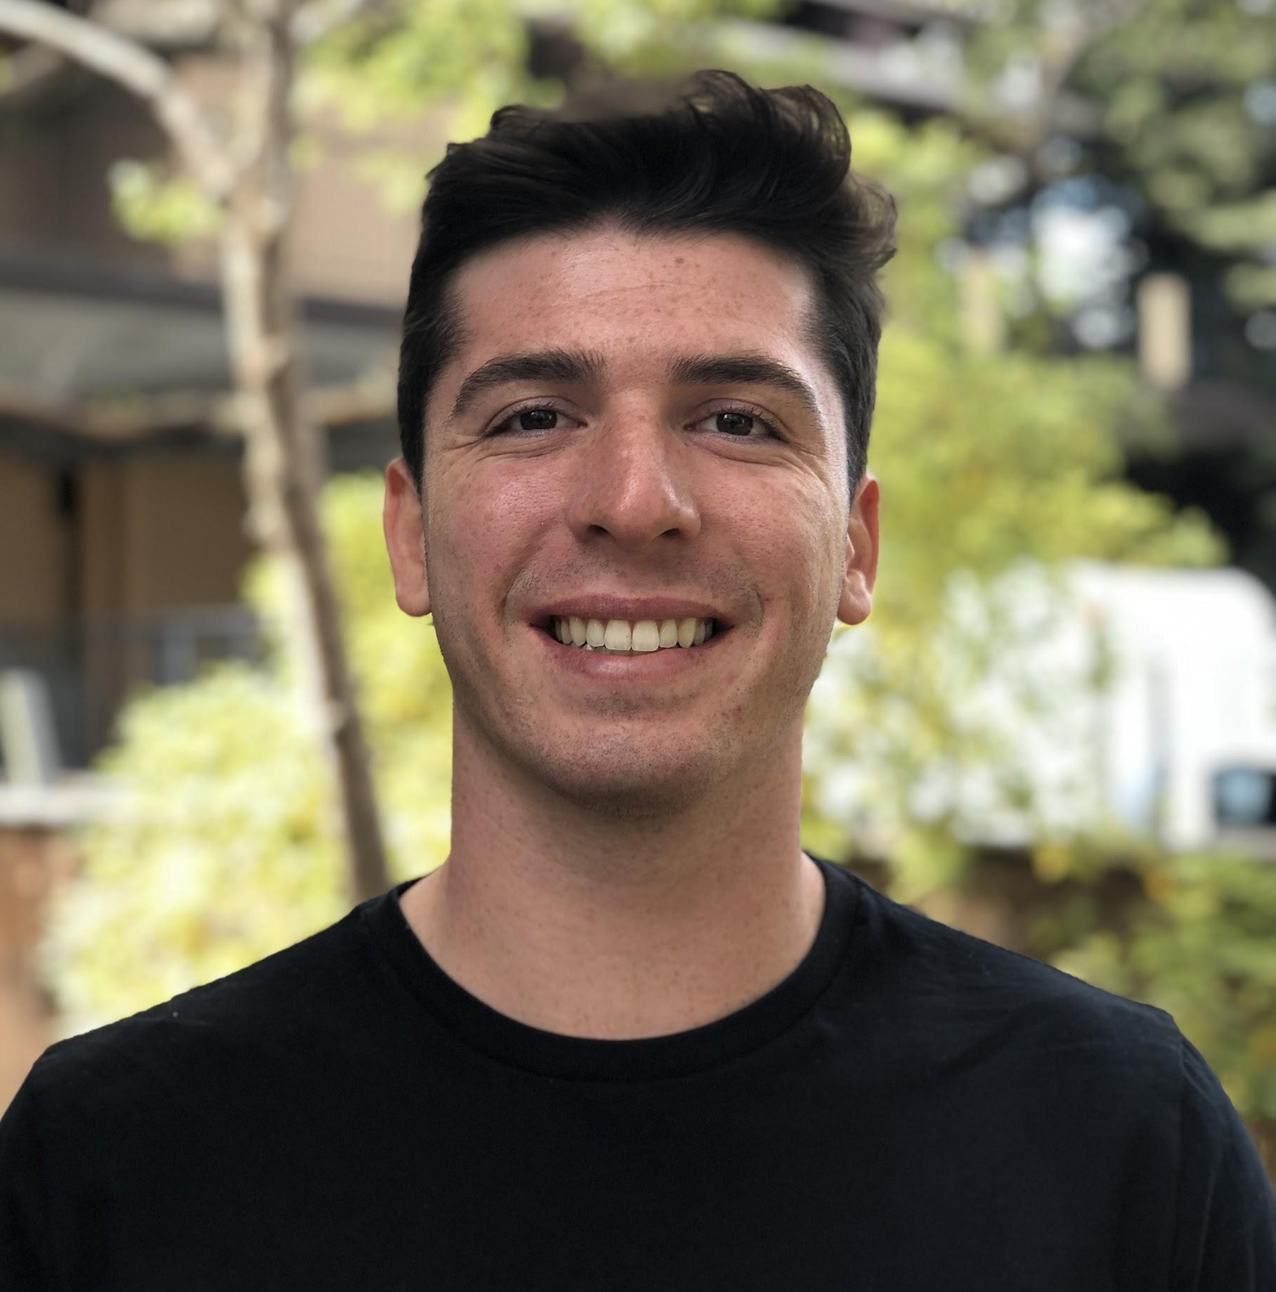
OUR TEAM
–
Vincent Nicandro
nicandro@stanford.edu
Has had a Starbucks gold
card since 2012
Lexi Stein
lexi@stanford.edu
Posted way too much in the
Class of 2019 page
Casey Wong
wongcs@stanford.edu
Insert something fun
and quirky here
Zach Goodale
zgoodale@stanford.edu
if (appliesToGoldman): sellSoul(Zach)

Slide 3
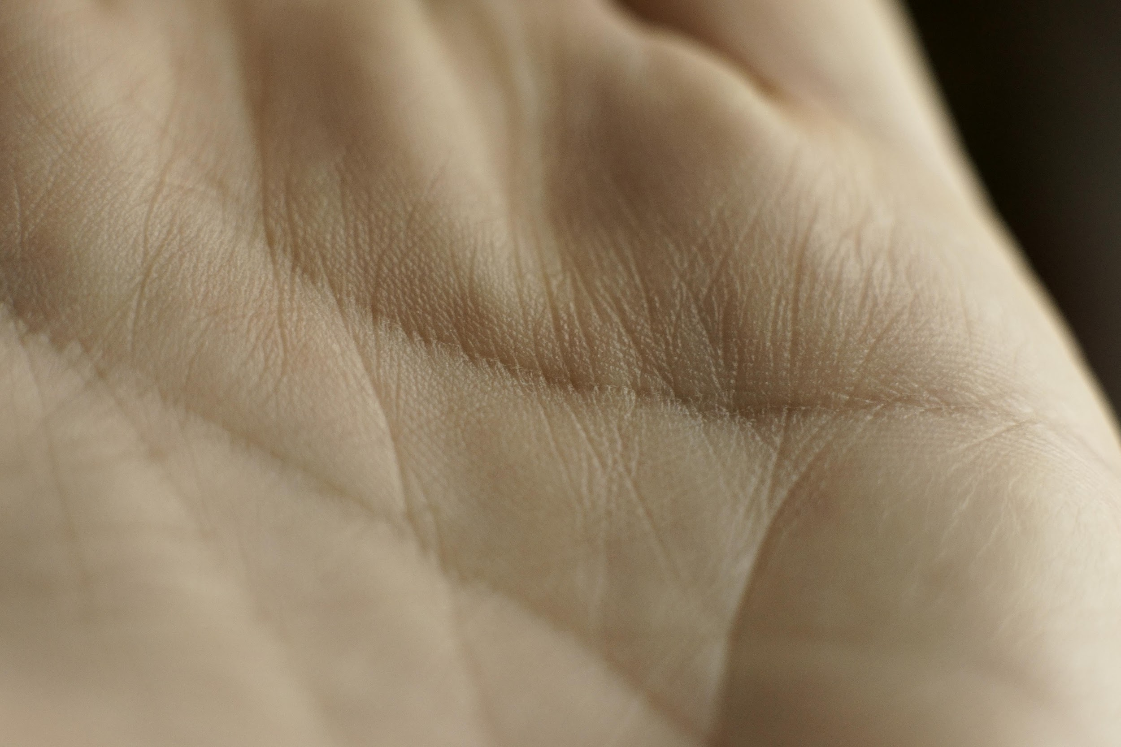
WE’RE INTERESTED IN
CREATING.
–

Slide 4
NEEDFINDING
METHODOLOGY
–
Create an interview guide.
Make basic, open-ended questions that digs deep for interesting stories.
1
Find subjects.
Seek interviewees from a diverse range of backgrounds.
2
Make an empathy map.
Seek out tensions, contradictions, and surprises to unpack and discuss.
3

Slide 5
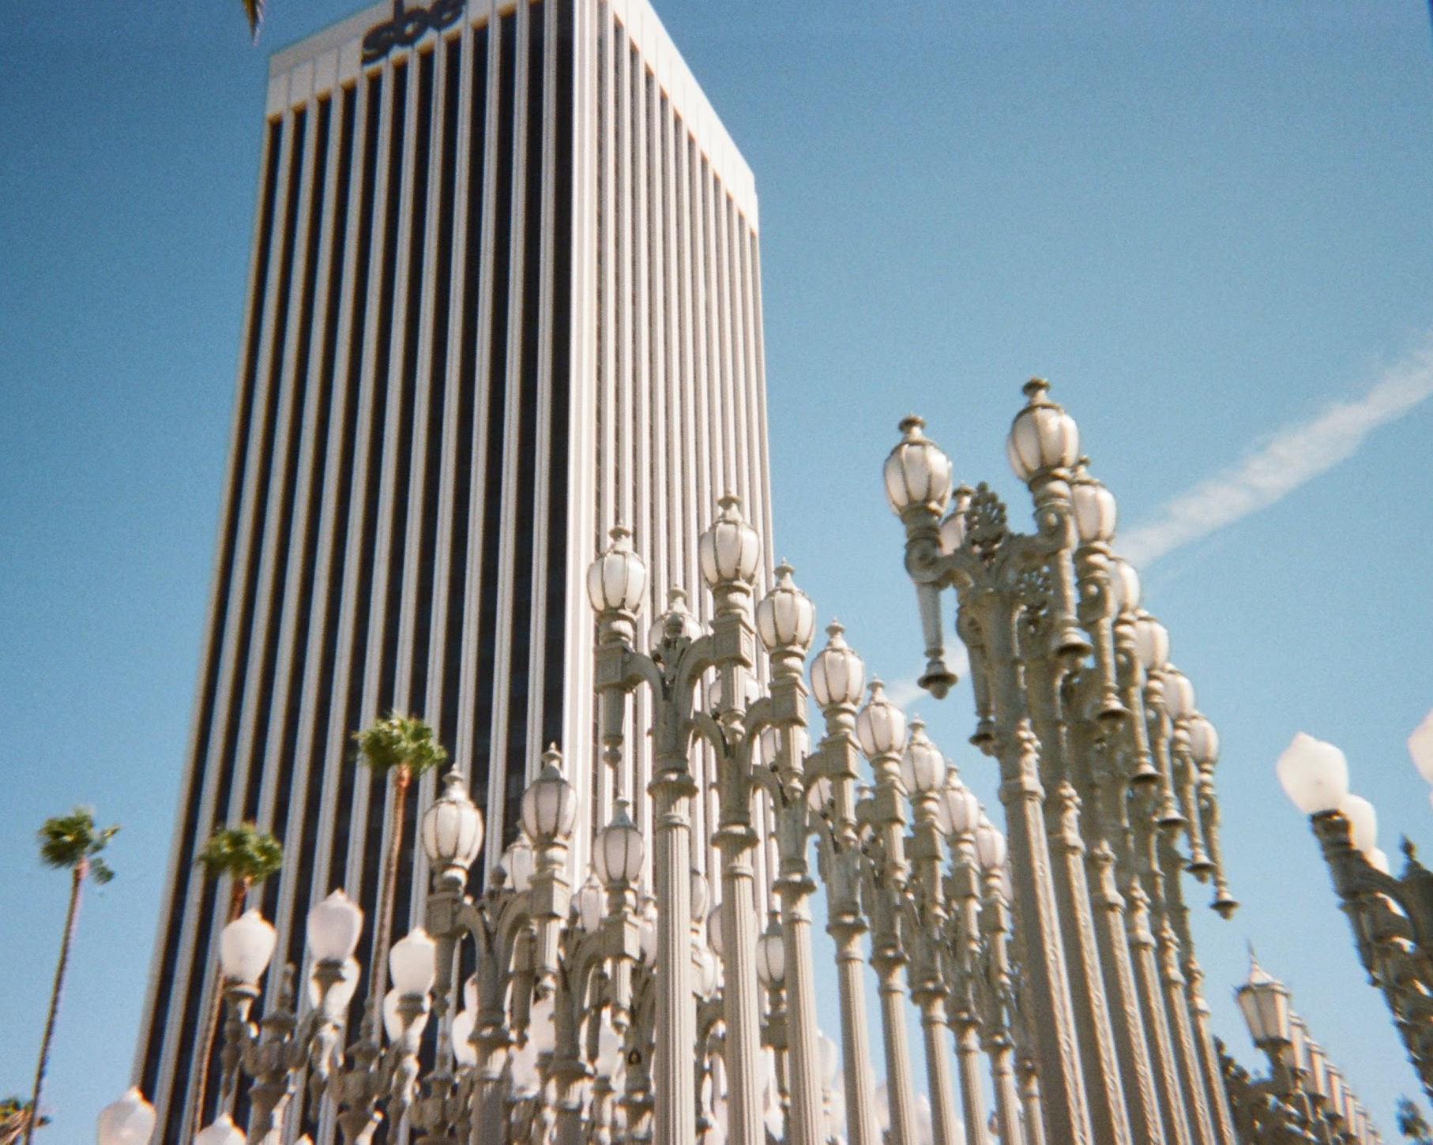
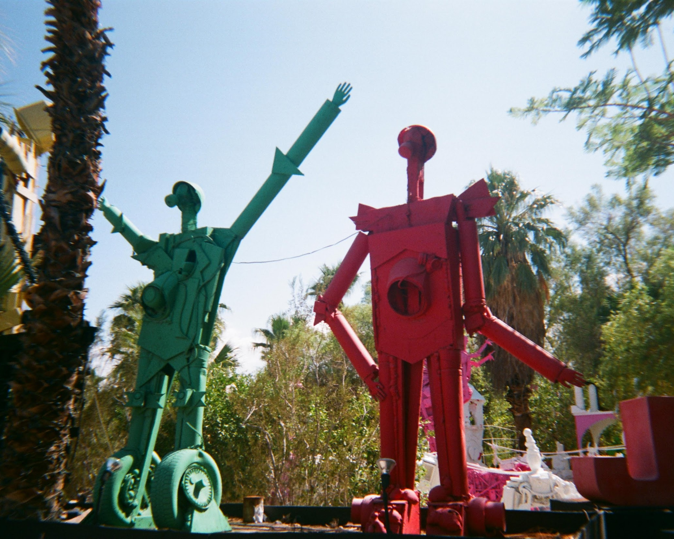
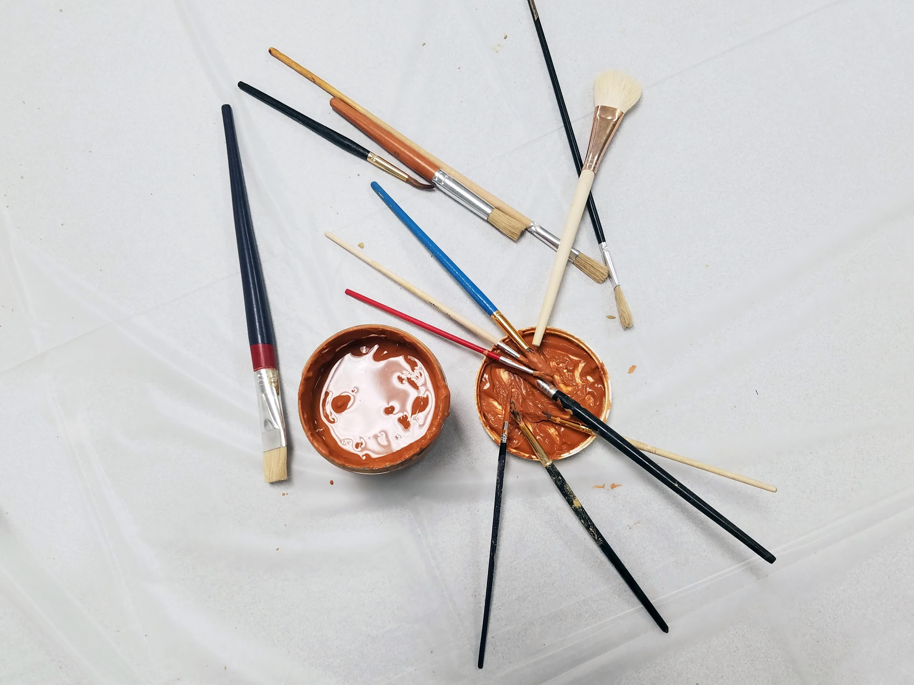
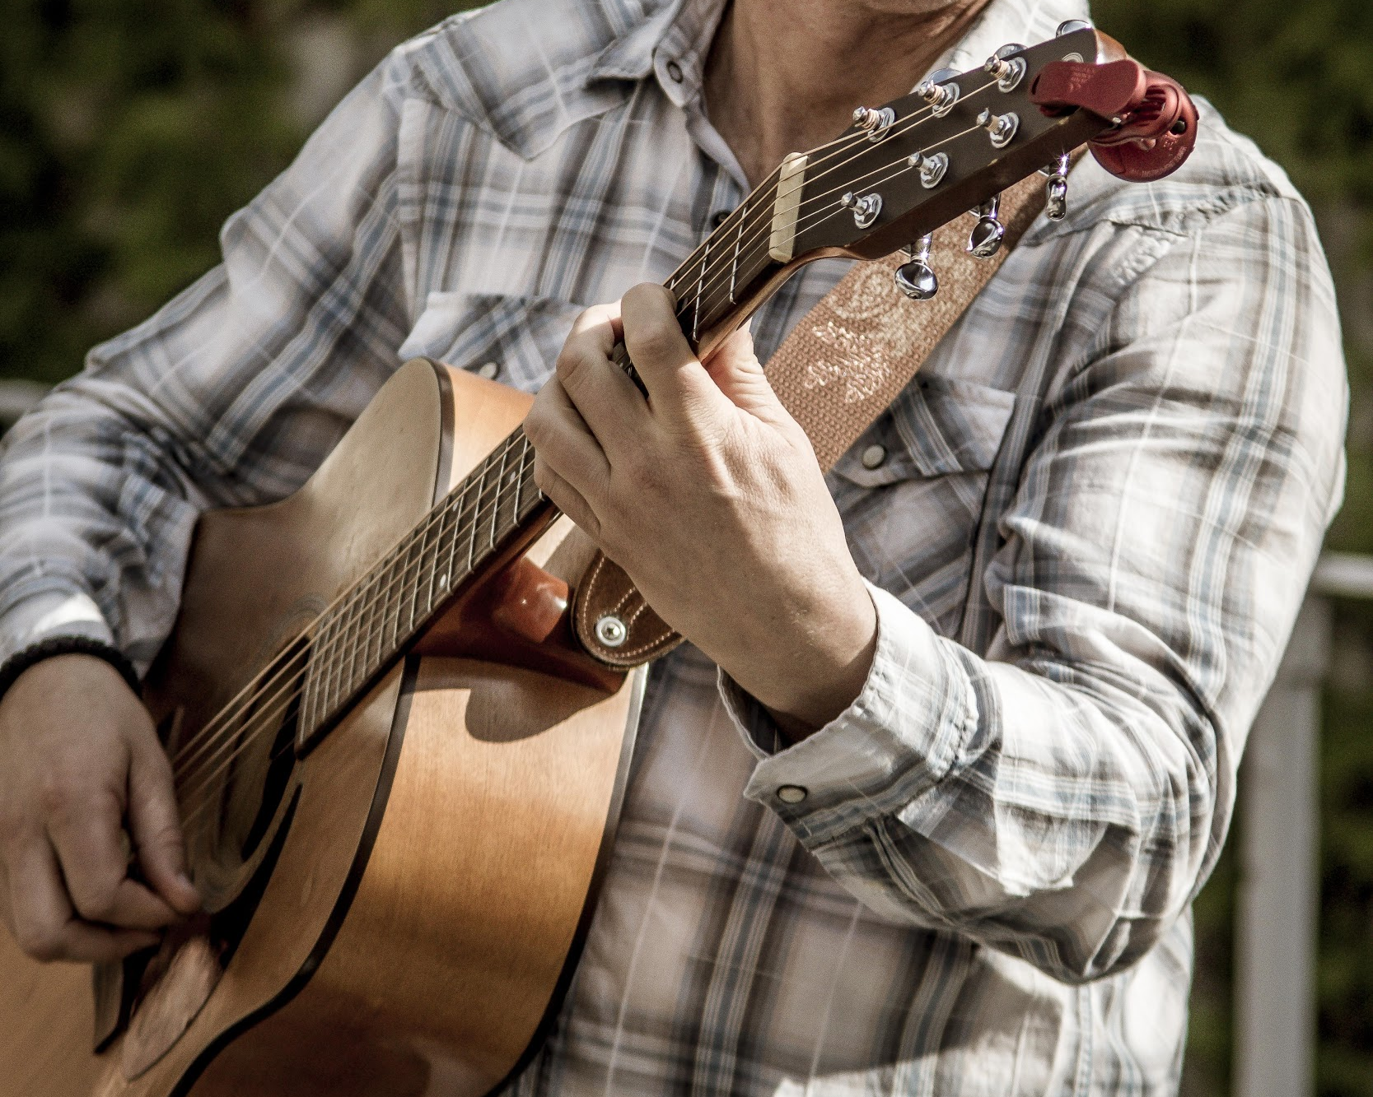
OUR QUESTIONS
–
What’s surprising about the way you create art?
How do you
assign value to art?
Where do you consume art?
What’s frustrating
about art?

Slide 6
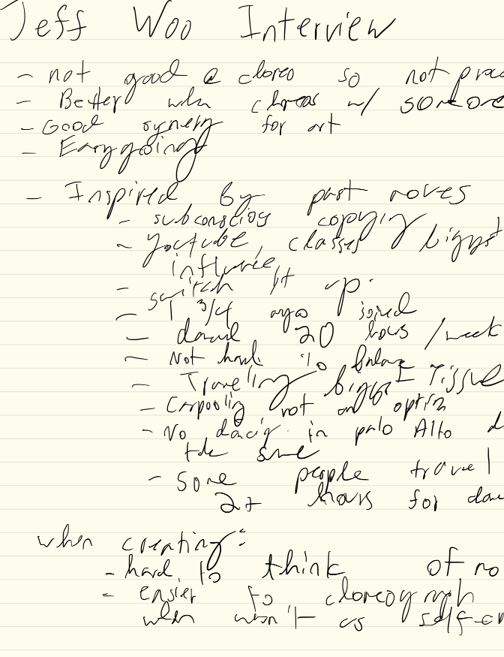
CONSIDERING
INTERVIEWS
–
Find their makerspace.
Interview them as best as possible in the environments in which they create.
1
Explain our goals clearly.
Tell them our goals for our project as well as their role in the process.
2
Have a conversation.
Be open, be inviting, and most importantly, be engaged.
3

Slide 7
INTERVIEWS
–

Slide 8
BIASES TO
RECOGNIZE
–
We interviewed creators.
In the future, we intend to also interview people who consume art.
1
We interviewed (mostly) men.
We want to ensure we’re capturing a diverse sample of artists and creators.
2

Slide 9
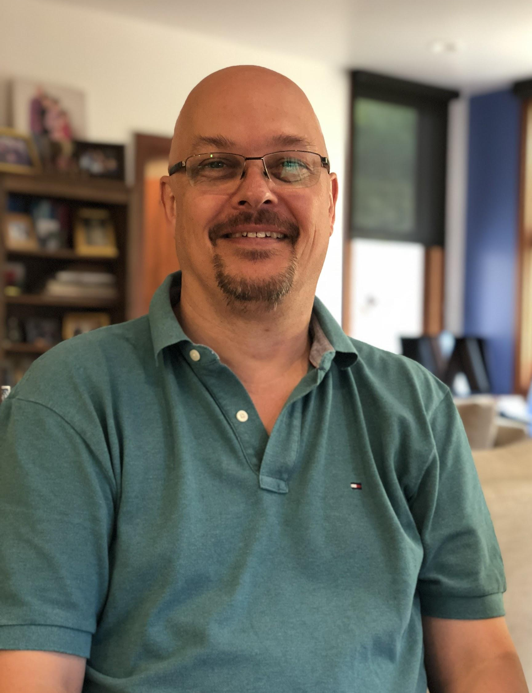
ANDY
TELECOM, MUSICIAN
–
Art changes people’s emotions.
It demands attention and forces us to think about the intentionality of a work.
1
Art should be accessible.
The institution of art can be daunting, but it’s our responsibility to dismantle that idea.
2
Art is an investment.
It requires energy and devotion and will and time and money to keep at honing one’s skill.
3

Slide 10
It’s like a hurdle I’ve got
to get over... just getting into the rhythm.
–
ANDY
ON FINDING TIME TO MAKE MUSIC

Slide 11
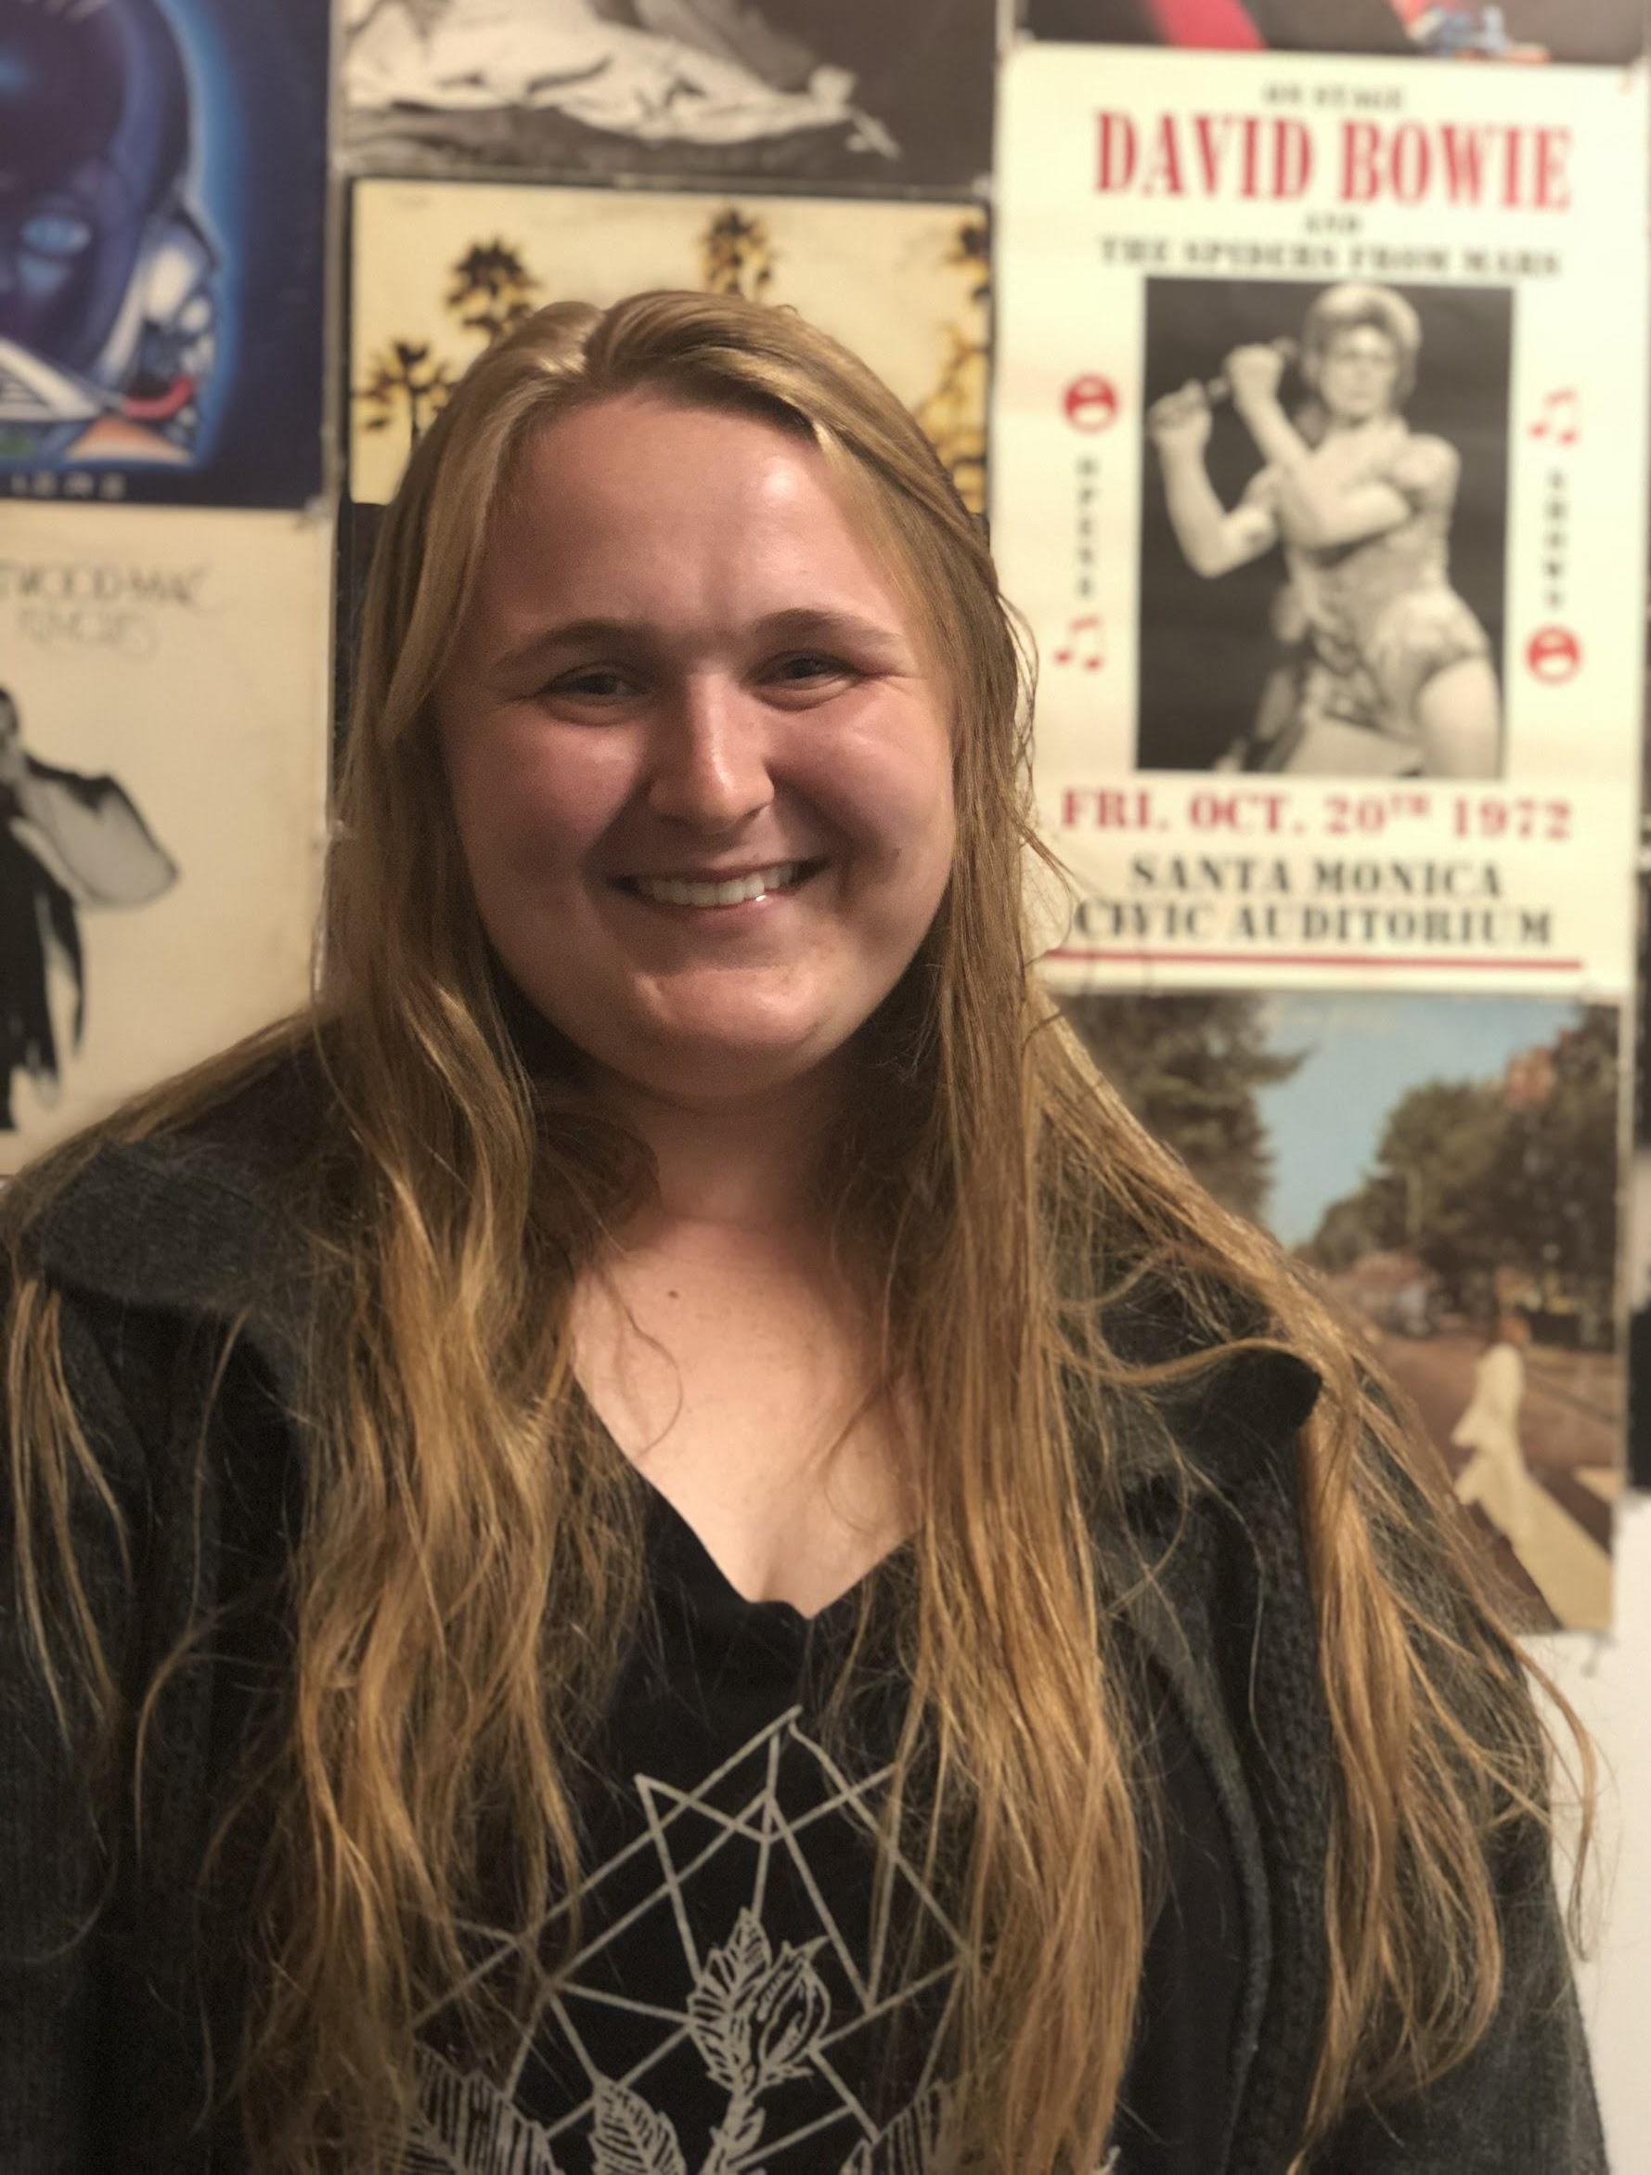
KYLEE
STUDENT, ARTIST
–
Art is entrenched in privilege.
The cost to be an artist is far more than one can typically make, acting as a barrier.
1
Art evokes our personality.
The pieces we carry with us and identify with reflect our own selves.
2

Slide 12
I enjoy being here… it’s a place I can come home to.
–
KYLEE
ON HER VINYL ALBUM ART WALL

Slide 13
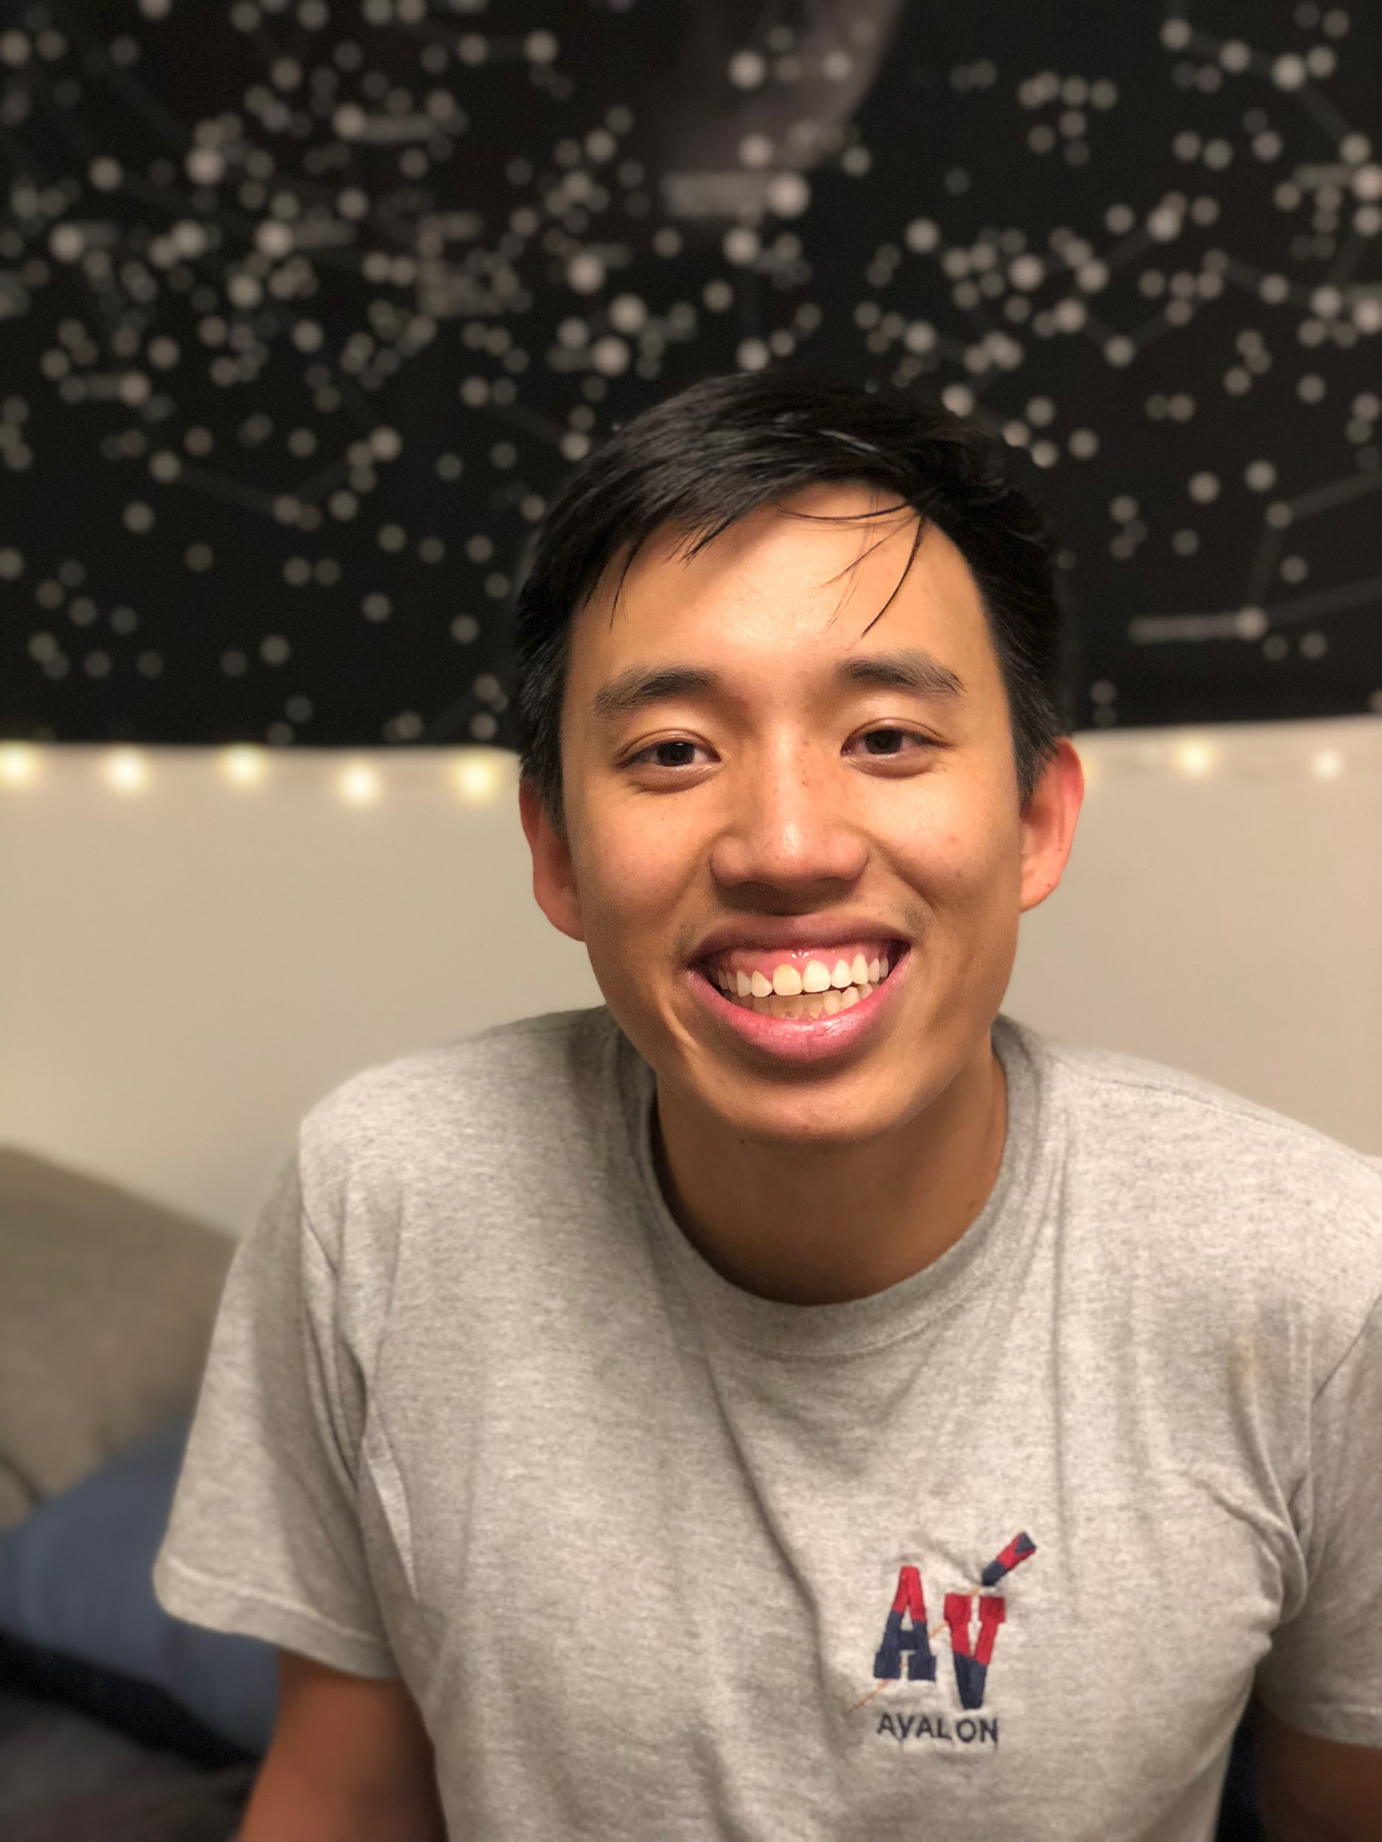
JEFF
COLLEGE GRAD, DANCER
–
Art is collaborative.
The ability to bounce ideas off of someone is invaluable in the process of creation.
1
Art is a struggle.
The places where we need to improve are the places we learn and grow the most.
2

Slide 14
I’m my own biggest critic; it’s hard to find the right language of movement.
–
JEFF
ON EXPRESSION THROUGH DANCE

Slide 15
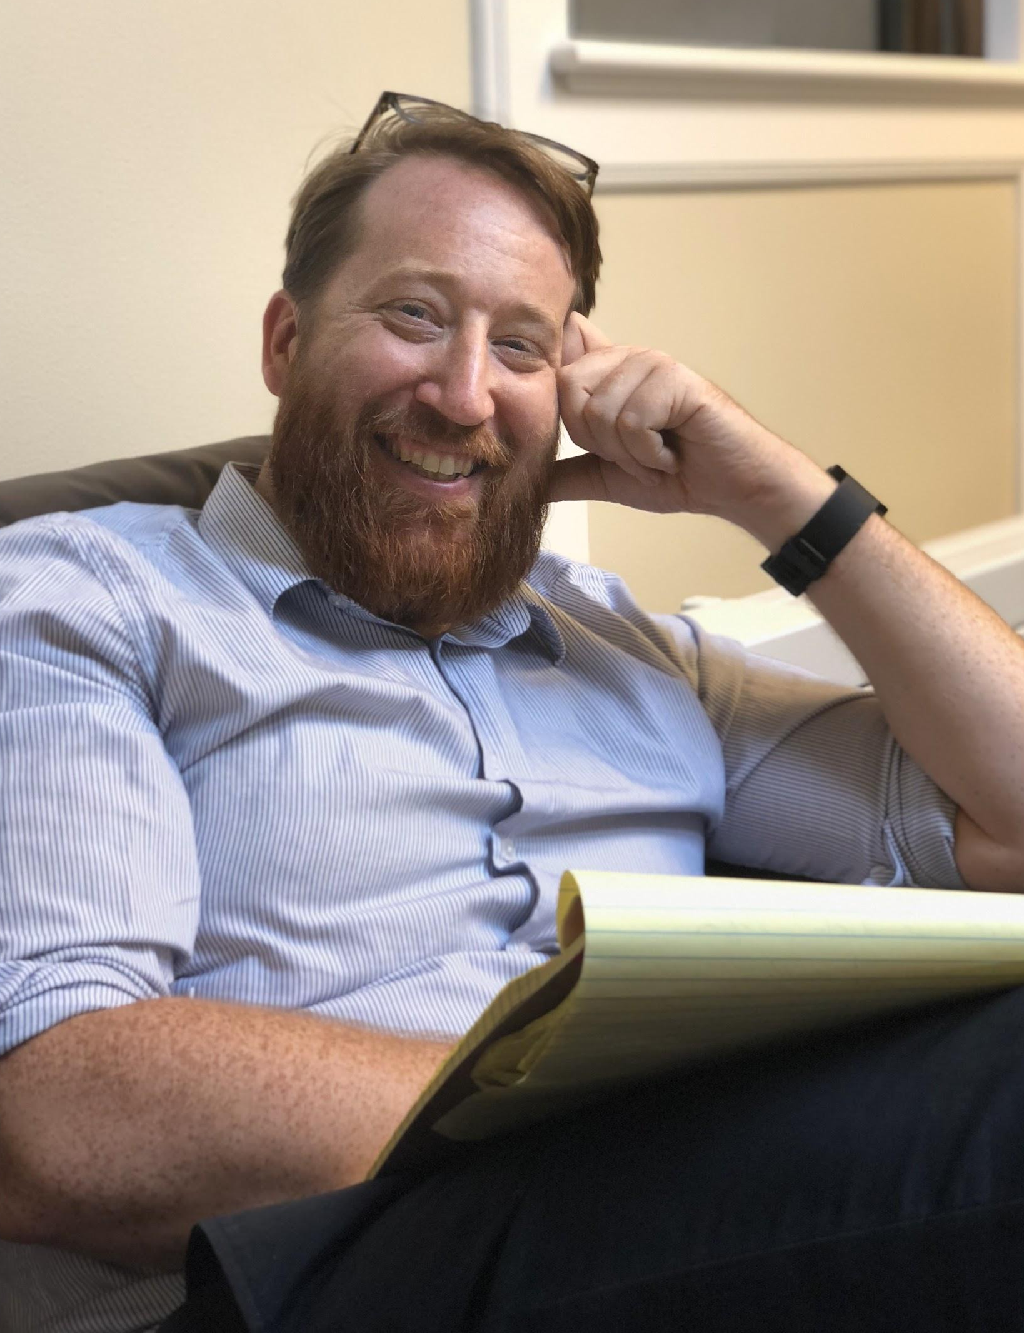
MICHAEL
PROFESSOR, DIRECTOR
–
Art is civic engagement.
Access to art should be defended as a constitutional right. It is a necessity.
1
Art is divisive.
There exists an ingroup/outgroup mentality in art that weakens the institution as a whole.
2
Art is genuine.
The point of art is to give someone a genuine experience, one that makes them think.
3

Slide 16
The medium we work in is human relationships, and they’re always messy.
–
MICHAEL
ON WHAT HE FOUND FRUSTRATING ABOUT ART

Slide 17
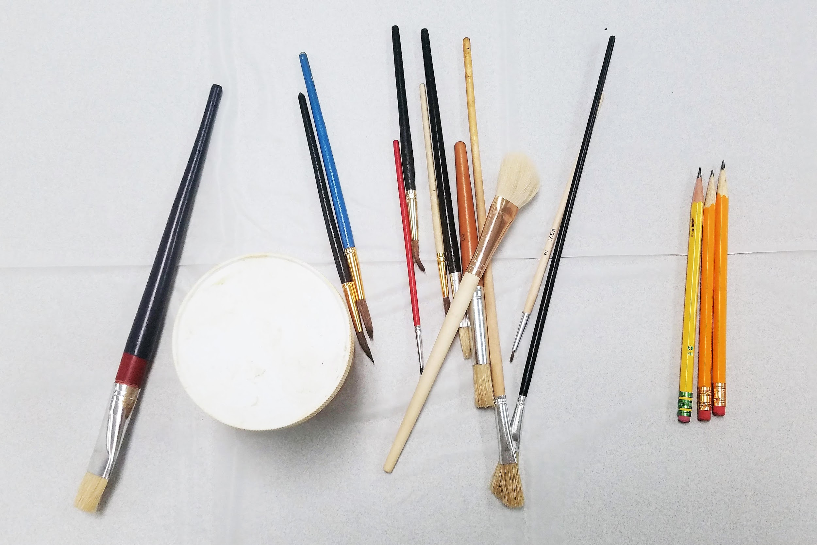
FINDINGS
–

Slide 18
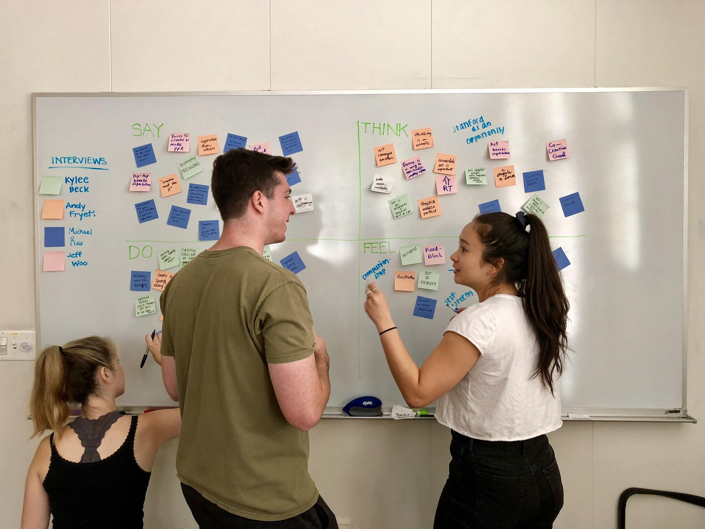
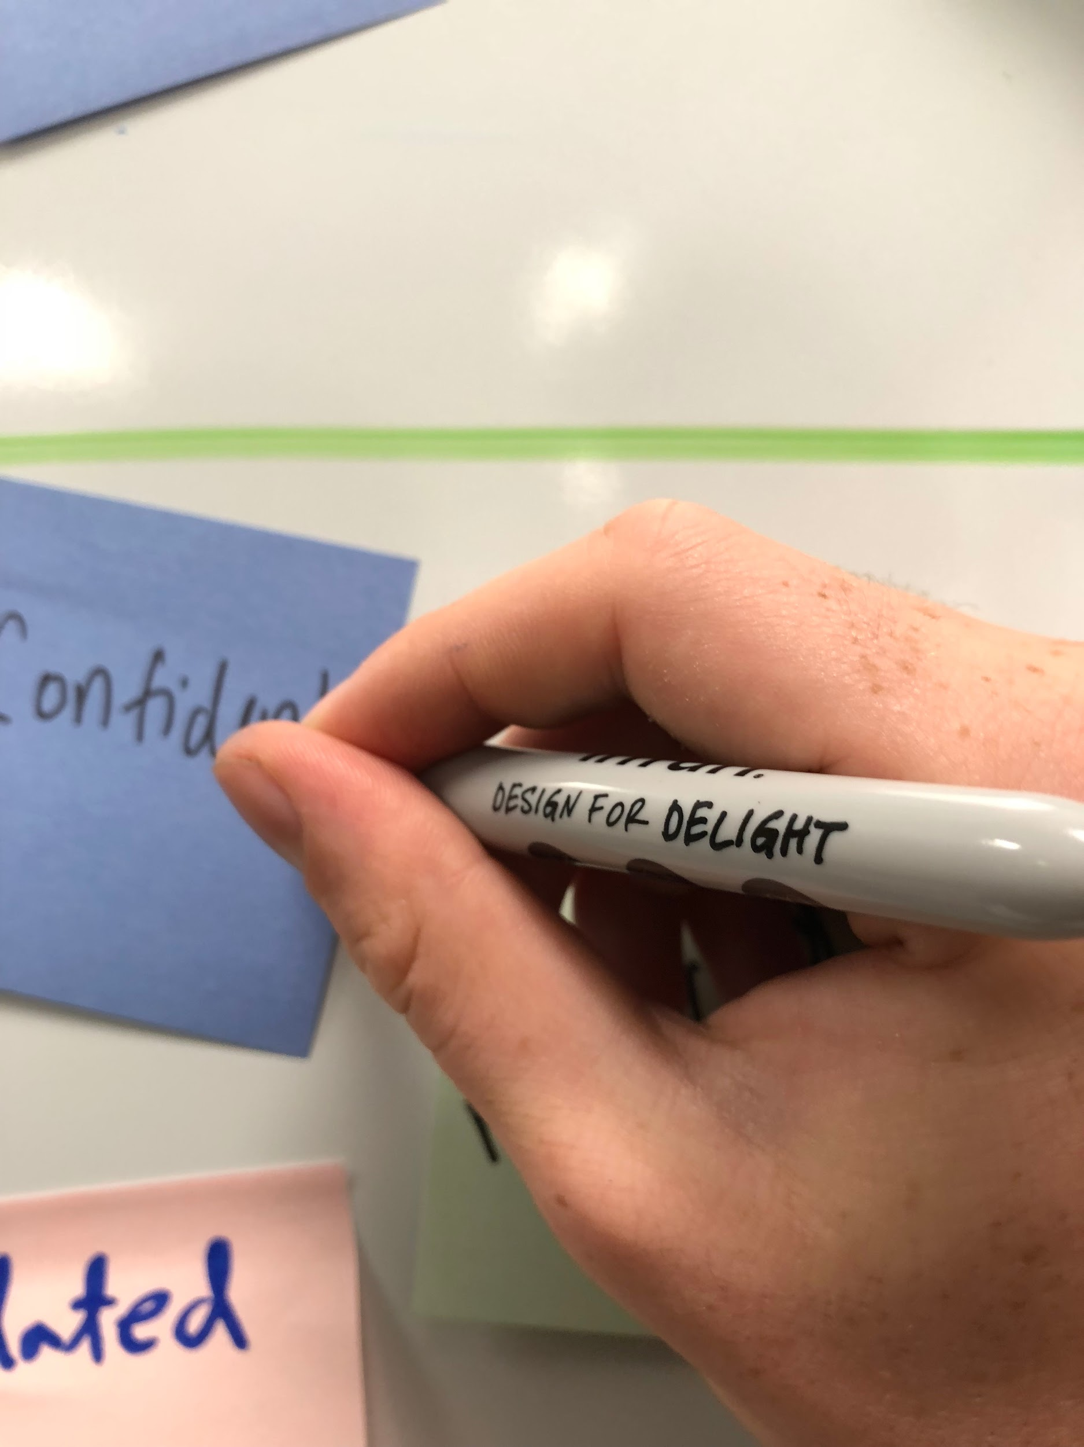
EMPATHY MAP
–

Slide 19
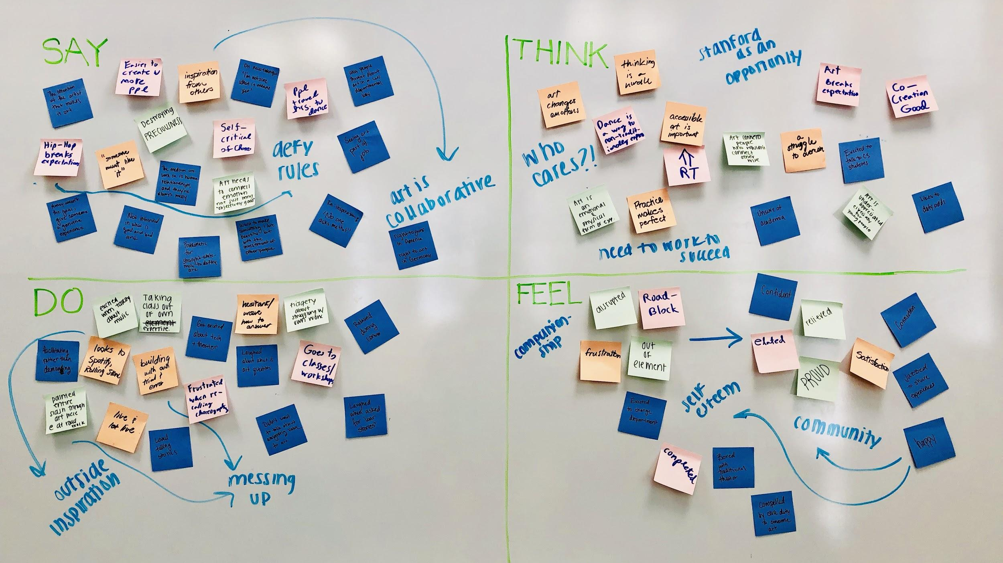

Slide 20
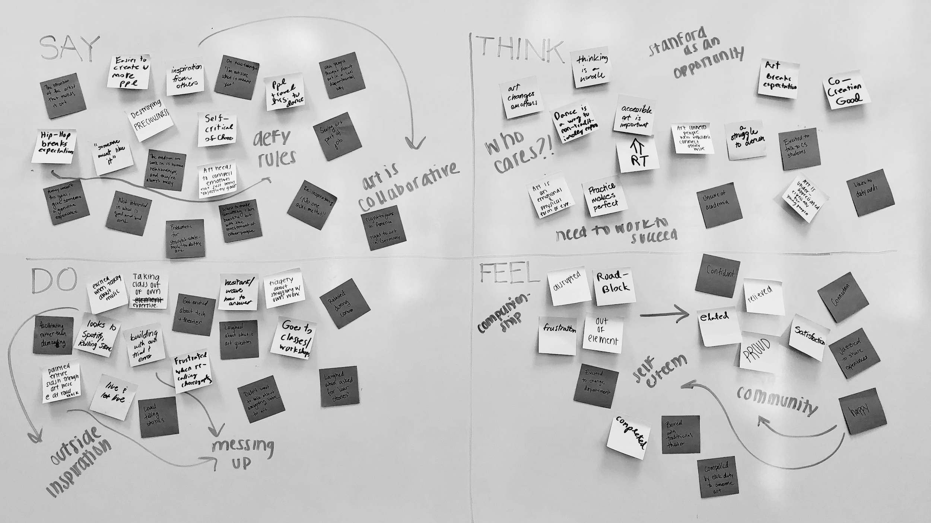
Art comes from a place of genuine human emotion, coming from a place of sincerity.

Slide 21
There exists a duality where struggling with creation is part of the satisfaction.

Slide 22
INSIGHTS &
NEEDS
I want to make something I love, but with the investment of other people.
–
INSIGHT: Art is a relationship, one that’s hard but necessary to maintain.
–
NEED: A way to facilitate the exchange of thoughts and ideas between creators.
MICHAEL
ON HIS DIRECTING STYLE

Slide 23
INSIGHTS &
NEEDS
It helps for me to have goals and targets to hit.
–
INSIGHT: Art is a journey undertaken by creators that requires investment of the self.
–
NEED: A way to have accountability built into the process of creation.
ANDY
ON HONING HIS SKILL

Slide 24
INSIGHTS &
NEEDS
When I find I’m too attached to a painting, I just mess it up.
–
INSIGHT: Art isn’t precious; it subverts and breaks expectations.
–
NEED: A reminder to let art be raw and messy, unbounded from limitations.
KYLEE
ON THE IDEA OF PRECIOUSNESS

Slide 25
INSIGHTS &
NEEDS
Part of the reason I dance is because it’s unexpected.
–
INSIGHT: Art in our community is limited by inaccessibility and misconceptions of the field.
–
NEED: A way to make art inviting and accessible to all communities.
JEFF
ON DANCING HIP HOP

Slide 26
INSIGHTS &
NEEDS
Think about
art in a less departmental way.
–
INSIGHT: Art is segregated and sequestered from other disciplines.
–
NEED: An interdisciplinary approach to creation and remixing.
MICHAEL
ON INTERDISCIPLINARY INTEREST

Slide 27
SUMMARY
–
Art as physicality.
The mechanics of creation and honing their skills to better themselves.
1
Art as intersectionality.
The compounding of identities and backgrounds and beliefs.
2
Art as people.
The relationships between people and how they interact and bounce off.
3

Slide 28
ANY
QUESTIONS?
–

